Slide 1
Guideline for Python environment setup
By Light wu

Slide 2
Agenda
Get PyCharm
Get Anadona
Little Tips about PyCharm
Test if you are going in the right way

Slide 3
Get PyCharm
Access to https://www.jetbrains.com/pycharm/download/#section=windows
Download community version of PyCharm

Slide 4
Get Anadona
Access to https://www.continuum.io/downloads#_windows
Get right release of Anadona for your local machine, we use 3.5
The Python version you choose in the installer affects only your root environment. You can then use the "conda" command to create new environments for any version of Python, whether 2.7, 3.4, or 3.5.
Setup Anadona for PyCharm https://docs.continuum.io/anaconda/ide_integration#pycharm

Slide 5

Get Anadona
Configure Anadona for PyCharm
Go to File -> settings -> Project: ^your project name^ -> Project Interpreter
Press the gear button to setup Anadona for PyCharm

Slide 6

Little Tips about PyCharm
How to run a Python Script?
Press ‘play’ button

Slide 7
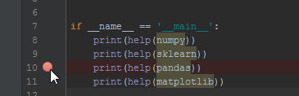

Little Tips about PyCharm
How to debug Python Script in PyCharm?
Set breakpoint
Press debug button

Slide 8
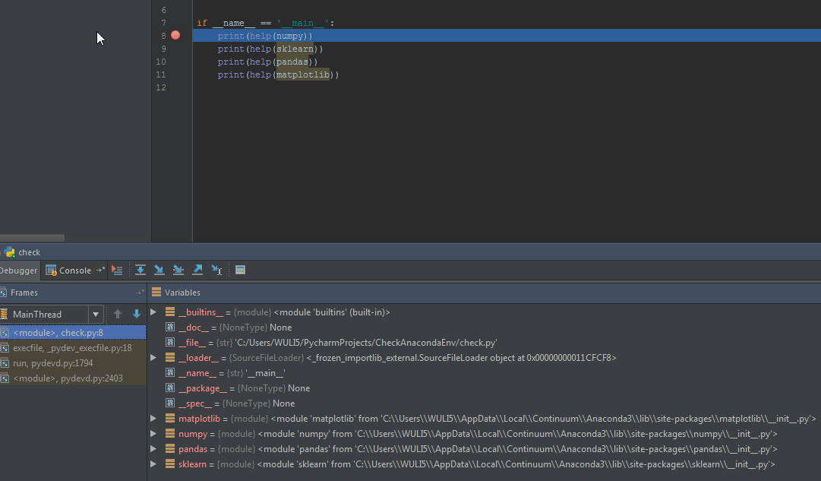
Little Tips about PyCharm
How to debug Python Script in PyCharm?
Checking all information u need

Slide 9
Little Tips about PyCharm
How to import a Project?
File -> Open -> <ur project’s root folder>

Slide 10
Test
Import sample project CheckAnacondaEnv to PyCharm
Run it!

